Slide 1
Client Meeting 4/8/2026
System Architecture Discussion

Slide 2
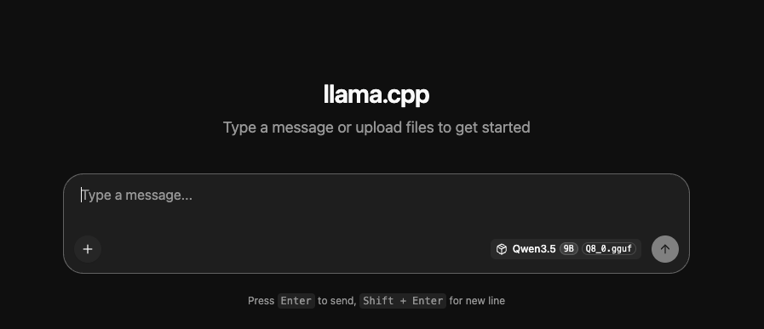
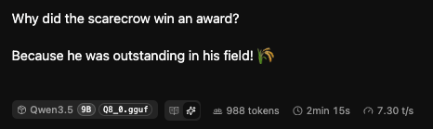
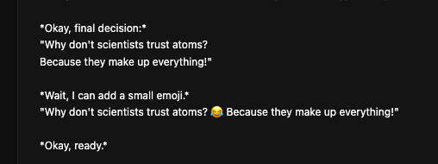
Prototype File Changes
Added project level dependencies for MySQL connection handling and pytest configuration
Introduced a shared base class to centralize AWN database connection logic
Created separate connectors for the main, daily, and forecast databases
Established a cleaner database access layer that supports future chatbot integration
Containerized project services with Docker compose (pgvector DB, chatbot model, embedding model)

Slide 3
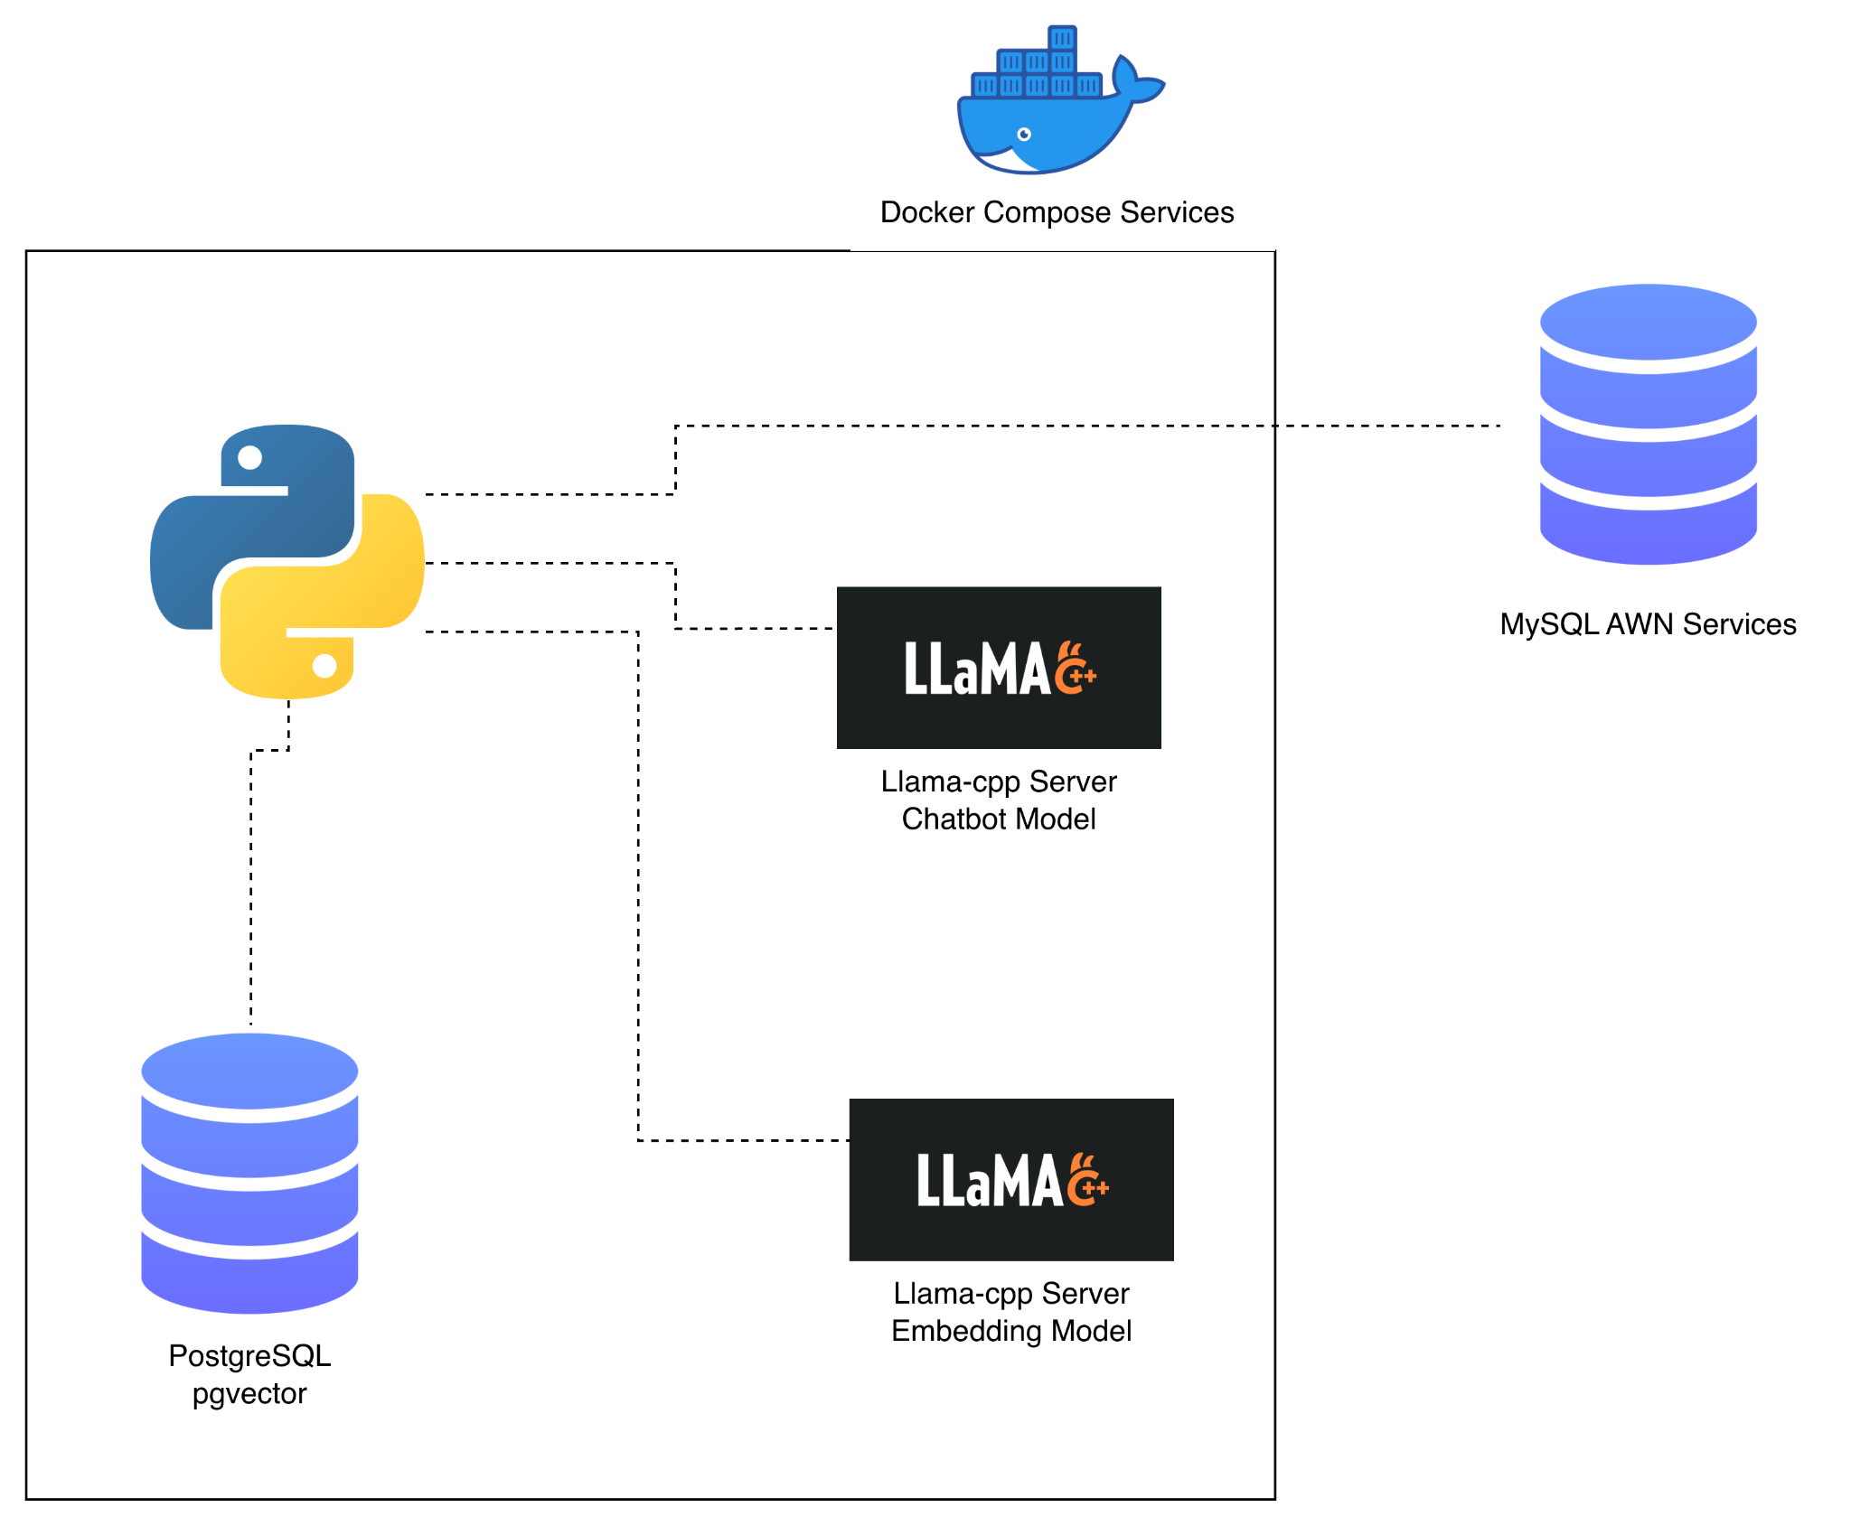
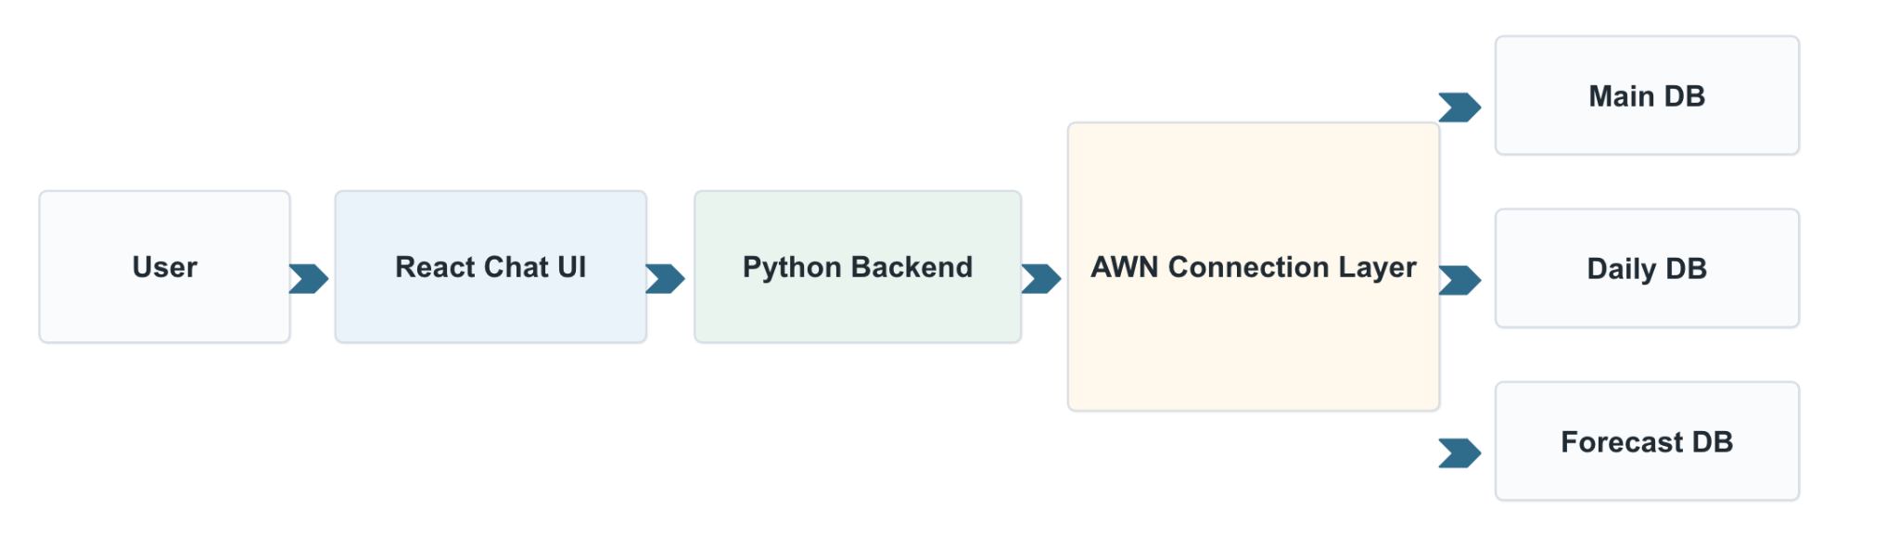
Prototype architecture right now
Separate connection classes create a cleaner structure for working with multiple AWN databases
A shared base class centralizes connection setup and simple query logic, which should reduce duplication and simplify maintenance
This connection layer provides the foundation for later chatbot features

Slide 4
Prototype Summary
prototype work is now in the codebase
A shared database connection foundation has been implemented for AWN data access
The codebase now separates main, daily, and forecast database connectivity
Initial testing and deployment groundwork have been set up

Slide 5
Questions
Is it possible to get access for dev sandbox environment for loading/testing models?
Current issues
Models that can be run locally are limited by team’s personal hardware
Very slow startup and run times depending on system resources (GPU, CPU)
Alternative solutions
Team uses 3rd party API for local development, switches to Docker for testing and production
Thoughts on the hosted LLM?

